Slide 1


Julie Mottisfont

Slide 2

£100,156.10

Slide 3
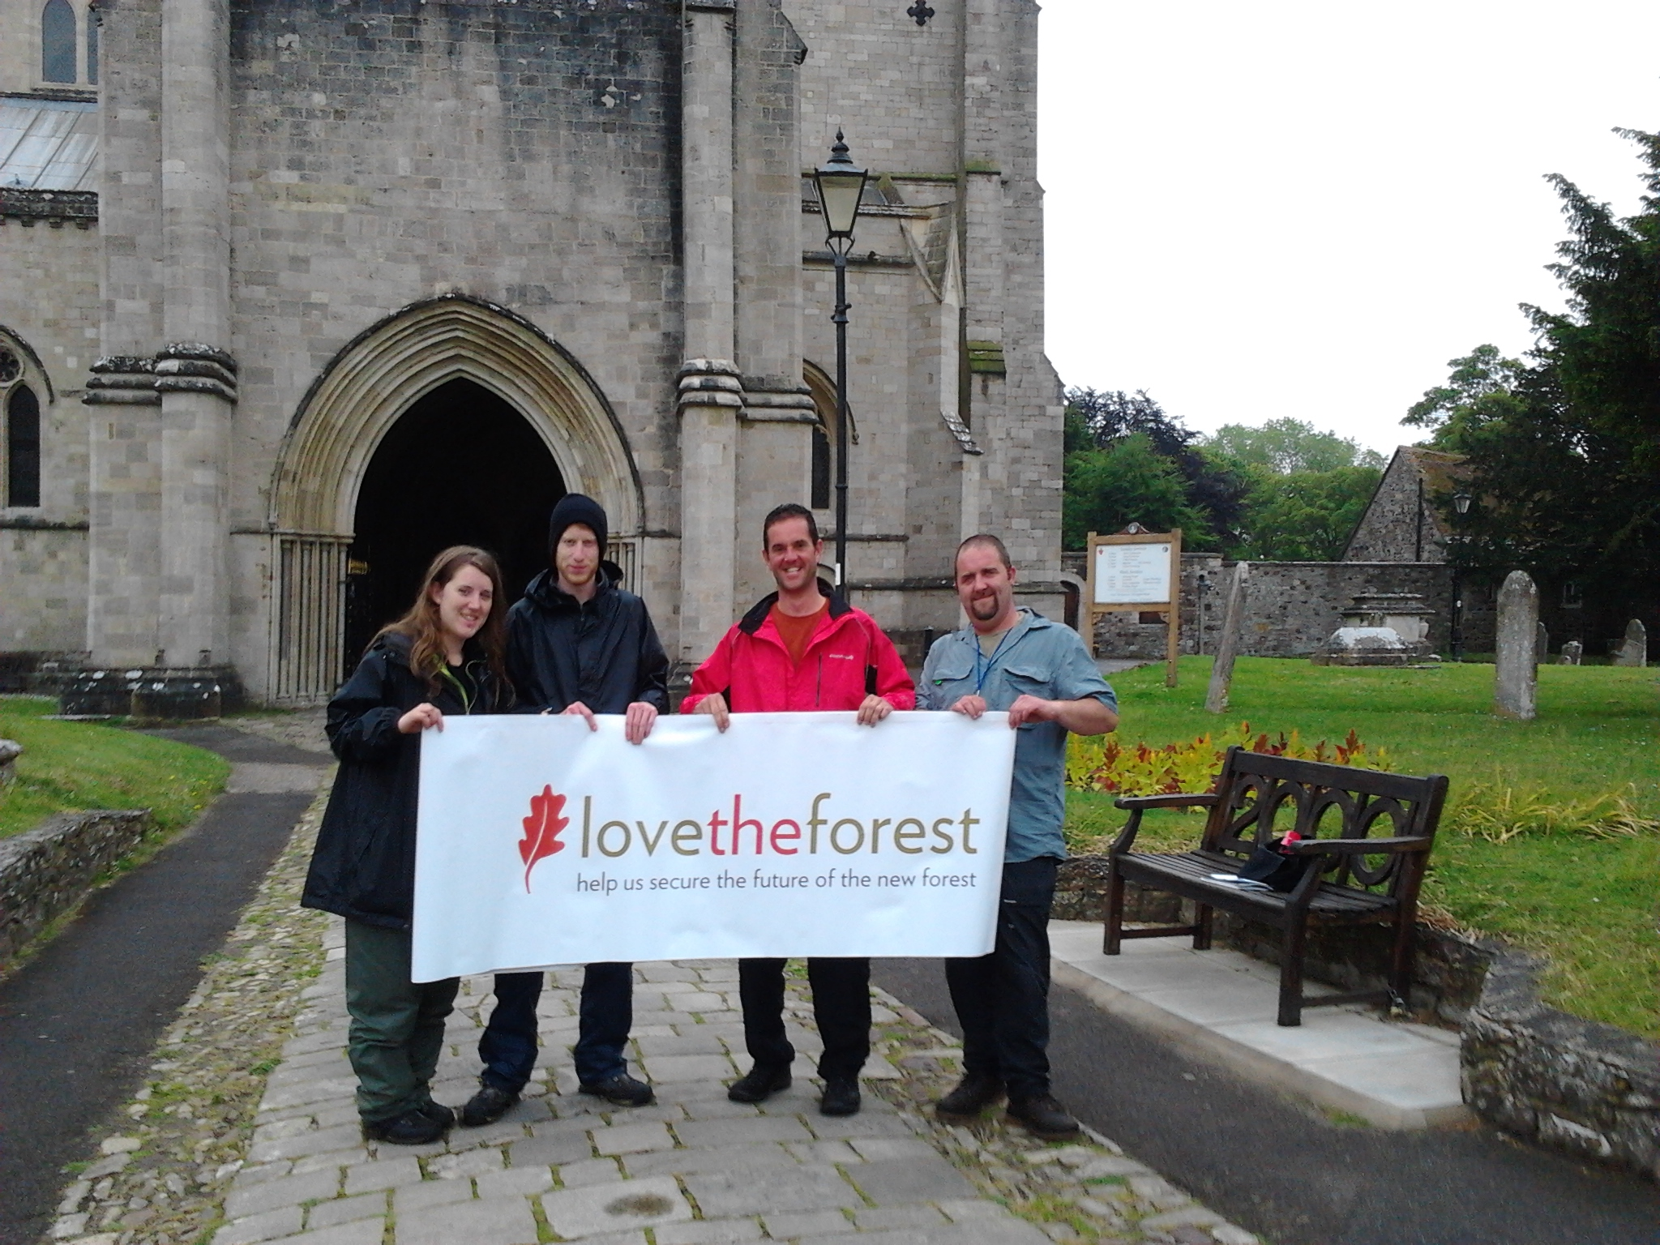

Slide 4
Thank you

