Slide 1
OPOF Monitoring Biodiversity -
Progress Report
6th February 2019
Sarah Jackson, Senior Ecologist

Slide 2
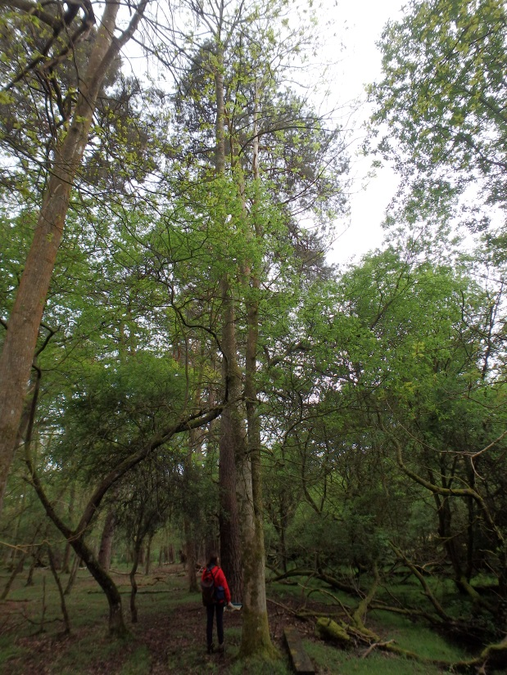
What is the ‘Monitoring Biodiversity’ project
Monitoring four of the delivery projects over 4 years.
Surveys of a selection of sites in each project
Monitoring visits to compare to baseline to see effects of management on biodiversity of the site

Slide 3
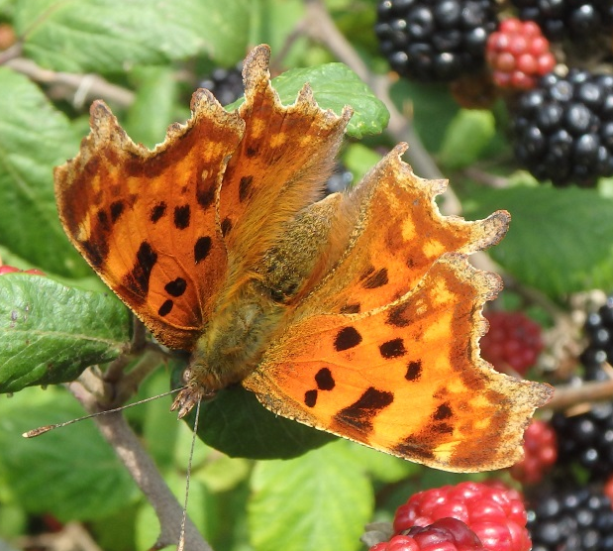
A range of surveys chosen for each site based on the habitats present, species it is likely to support and nature of works:
  Butterflies
  Bumblebees
  Birds
  Bats
  Odonata (dragonflies and damselflies)
  Reptiles
  Botanical surveys - hedgerow and woodland condition assessment
Surveys are undertaken by the Trust; professional, skilled and trained volunteers; and University of Southampton students and placements.

Slide 4
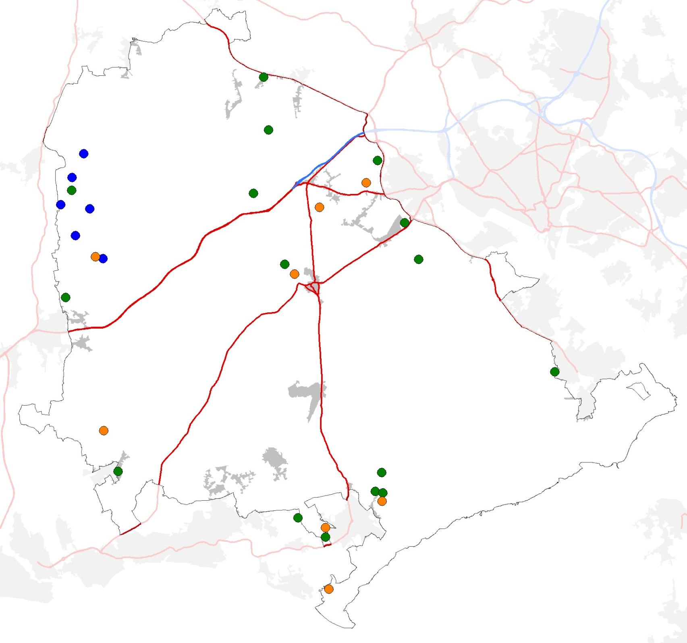
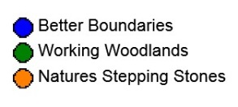
Final Year
Repeat of all sites surveyed to date
Between 2 and 4 years of data for analysis
 | Year 1 | Year 2 | Year 3 | Year 4 | Target Total No. of Sites
BB | 6 | 8 | 8 | 8 | 7
NSS | 9 | 13 | 11 | 11 | 18
WW | 8 | 15 | 20 | 20 | 16
NFNNS | 10 | 10 | 10 | 10 | 10

Slide 5
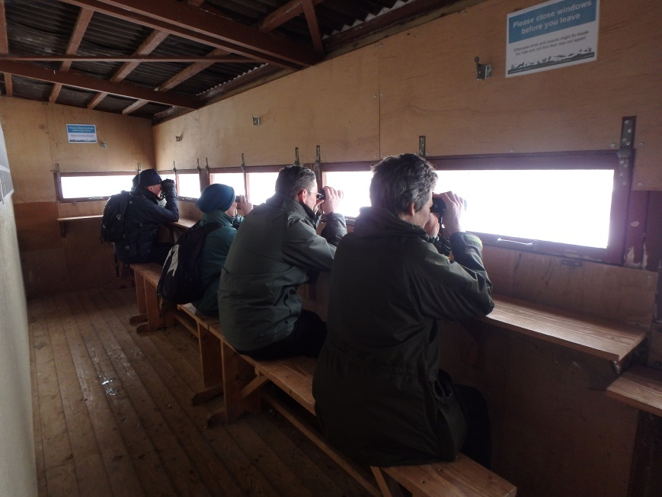
Volunteers
New & returning surveyors – 28 returning volunteers
Volunteer days = 173 days to date
Provided bird, bumblebee and butterfly training days for volunteers
Two sites included in University of Southampton 2nd year course – Warren Copse & Avon Tyrrell
Two university placements

Slide 6
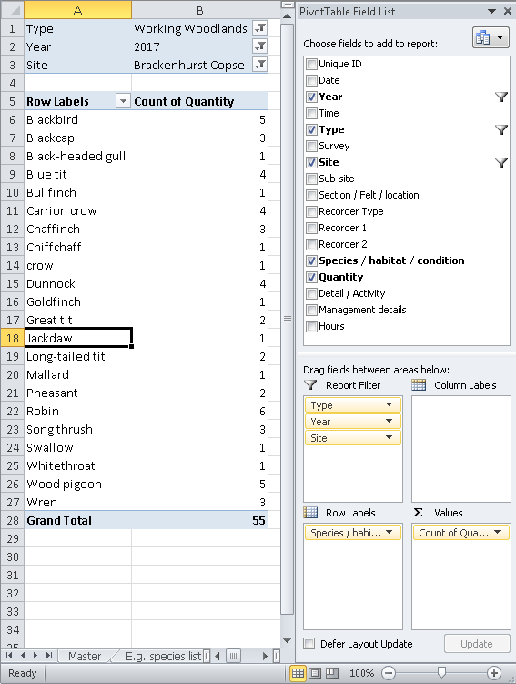
What are we doing with the data?
Master spreadsheet containing all survey results
Visual representation
- using GIS – bird, bat, rhododendron
- Fixed Point Photography (FPP)
Comparison by site of baseline with final year of monitoring
Picking out highlights at species and habitat level
- indicator species e.g. barbastelle
- number and diversity of species

Slide 7
Challenges
Finding landowners / sites
Retaining sites for duration of project – changes in landowner, not following MoU
- Not reached target number of sites for Natures Stepping Stones, but have for other projects
Data collection – very short window to demonstrate success, particularly in woodlands

Slide 8
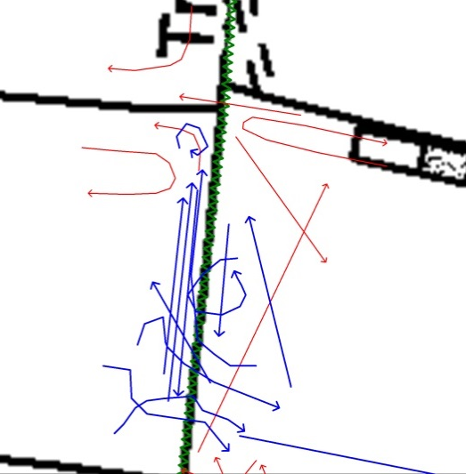
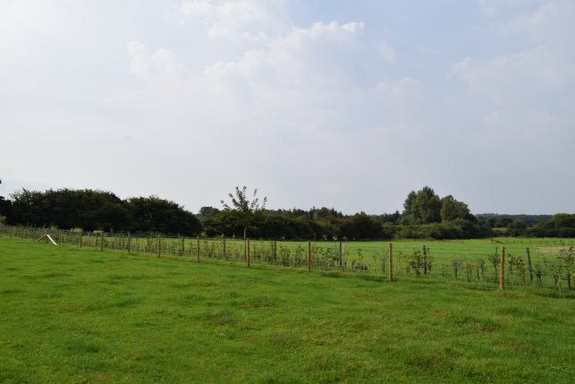
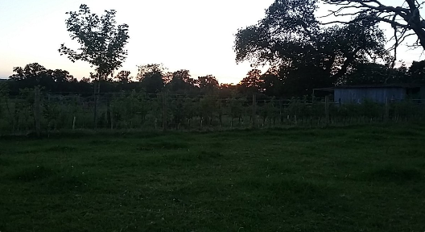
Signs of Success
Newly planted hedgerow in BB was used for the first time in 2017 by common pipistrelle bat
2016
2017

Slide 9
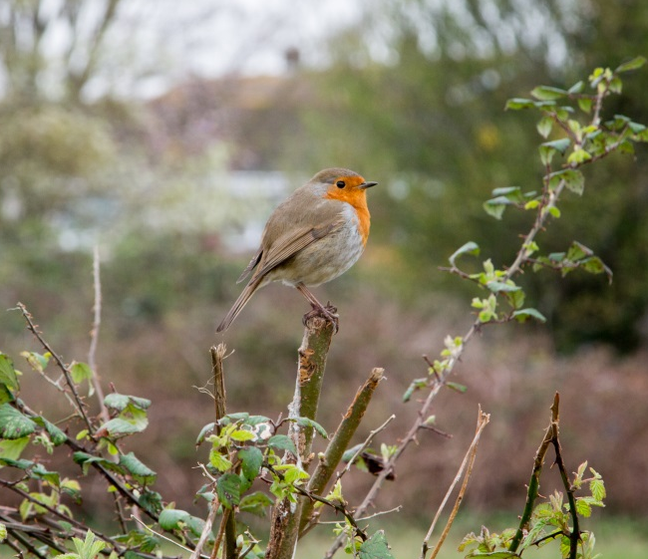
Works to restore hedgerows are having a positive effect on bird numbers and species

Slide 10
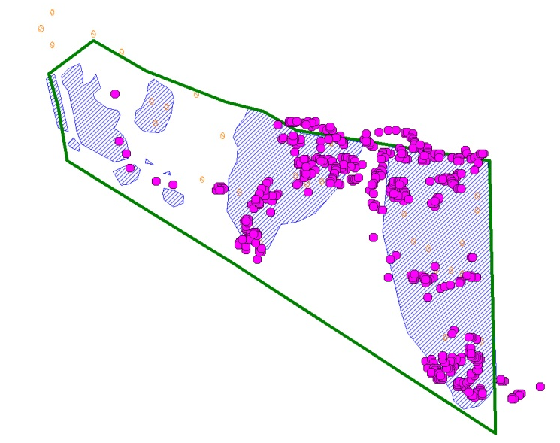
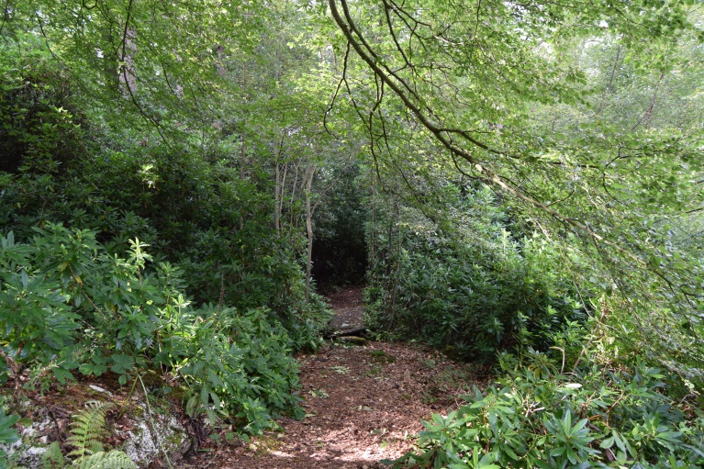

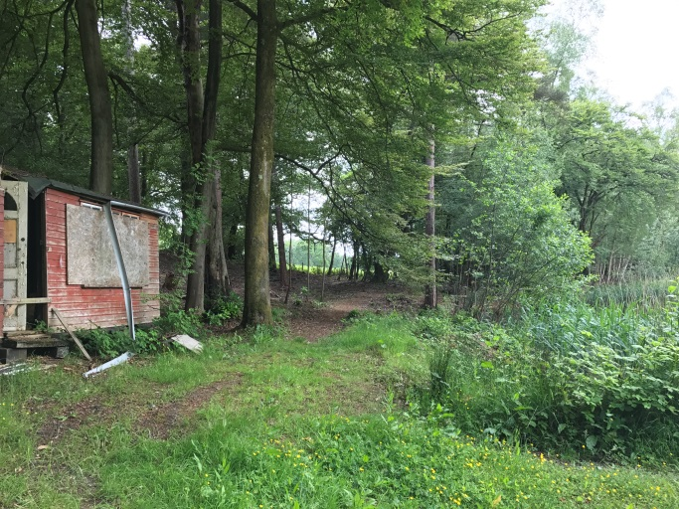
Battling Rhododendron - an average reduction of 83%, with one site having removed 98%
Butterfly Records

Slide 11

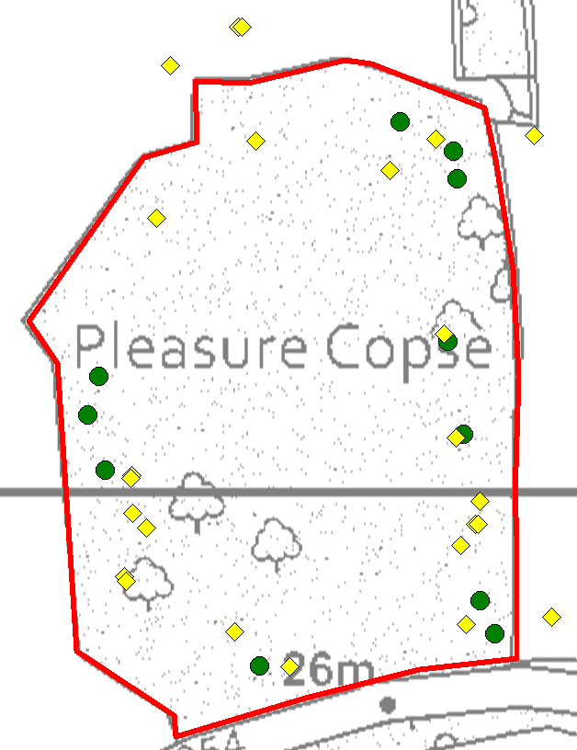
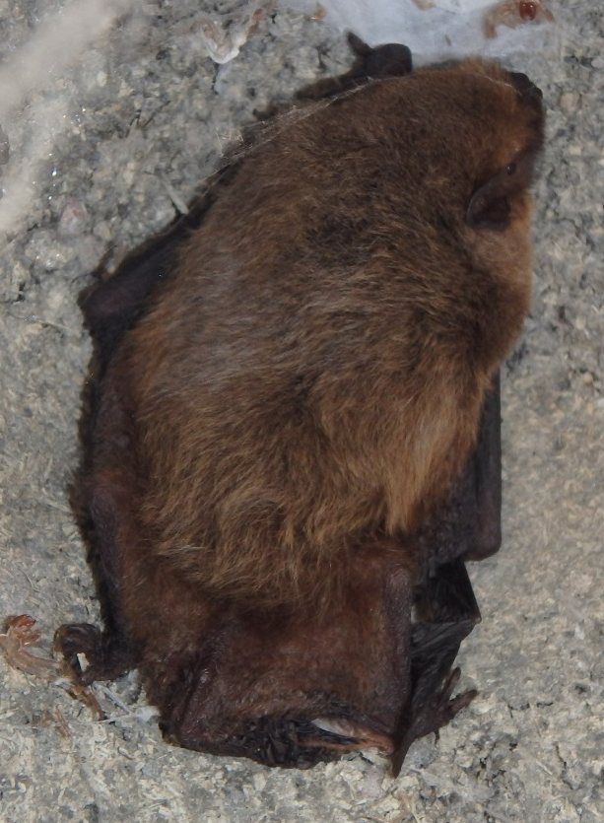
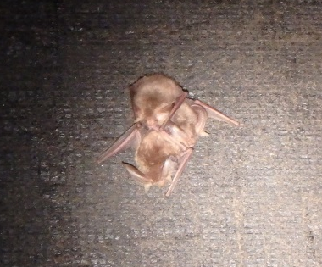
Increased bat activity following works on WW site

Slide 12
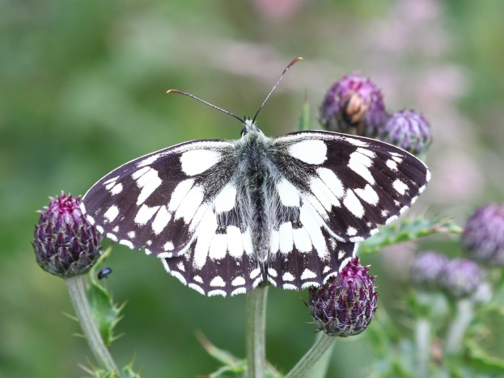
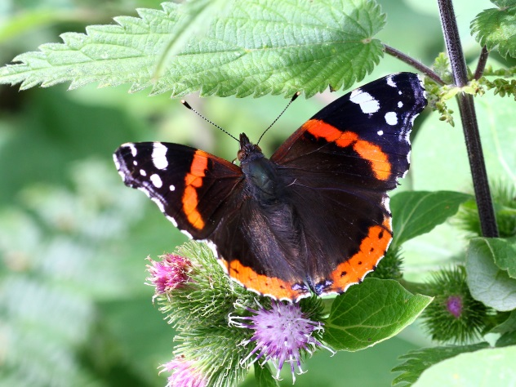
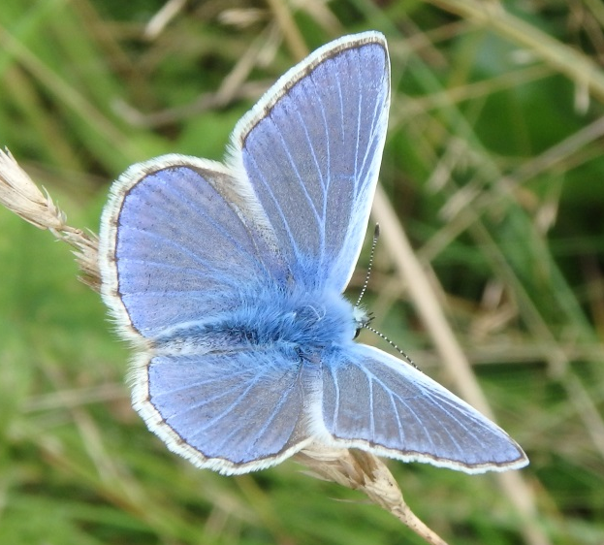
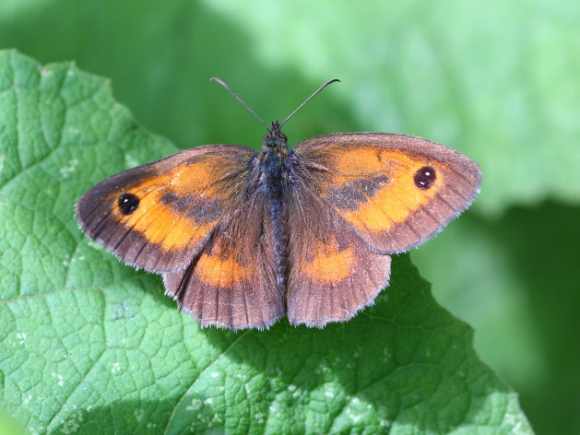
Butterflies are also benefitting from scrub and tree management works on a meadow and copse owned by one landowner

Slide 13
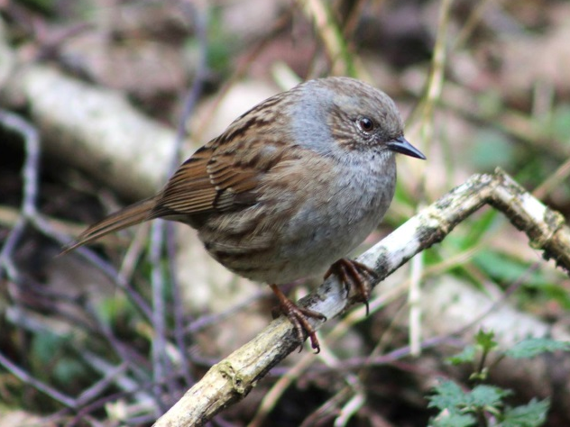
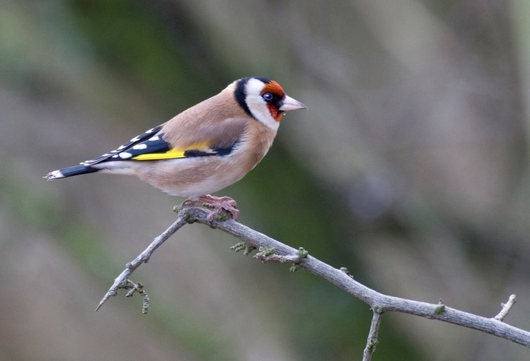
And birds on another site in both NSS & WW
Goldfinch on Twig by Darin Smith

Slide 14
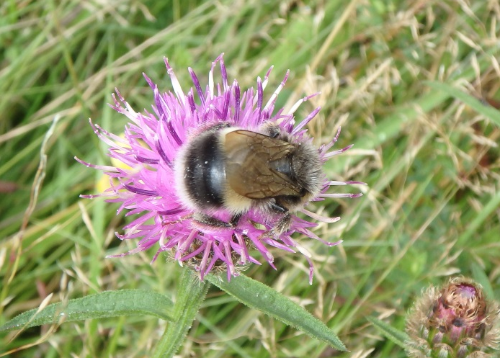
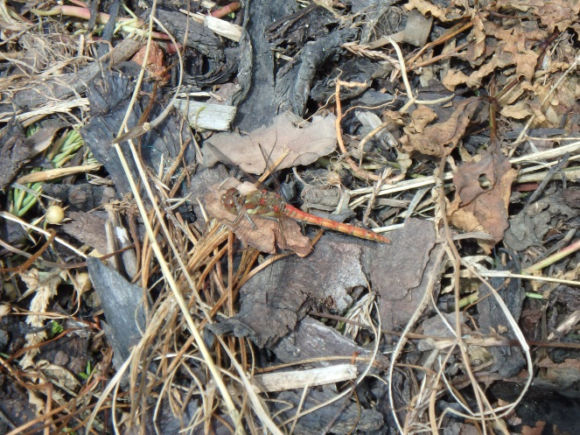
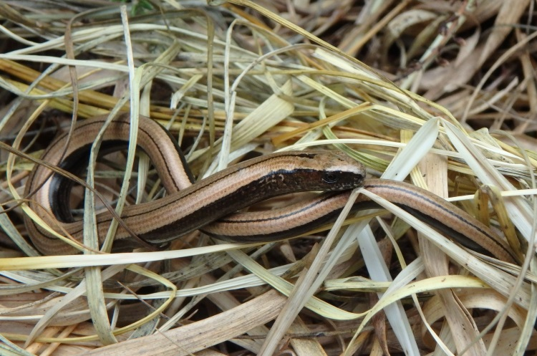
Records
6959 new records for 208 species
Arranging data sharing agreement with landowners so these can be shared with Hampshire Biodiversity Information Centre / County Recorders

Slide 15
Any Questions?

