Slide 1
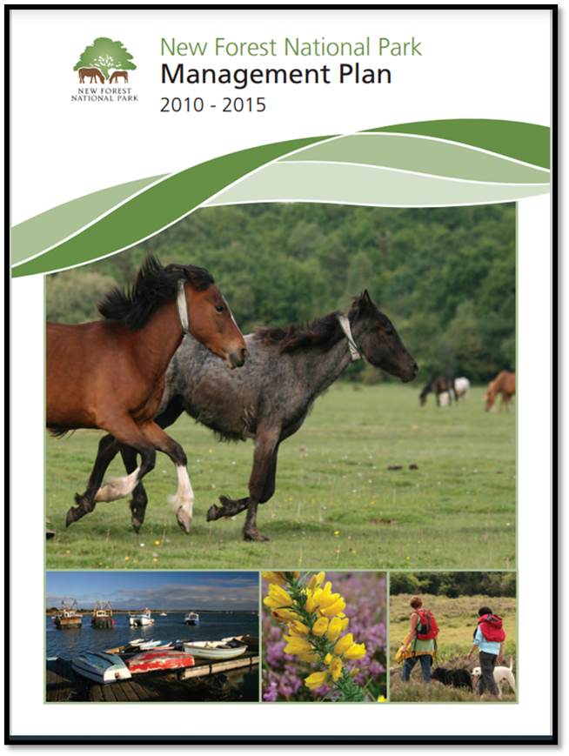
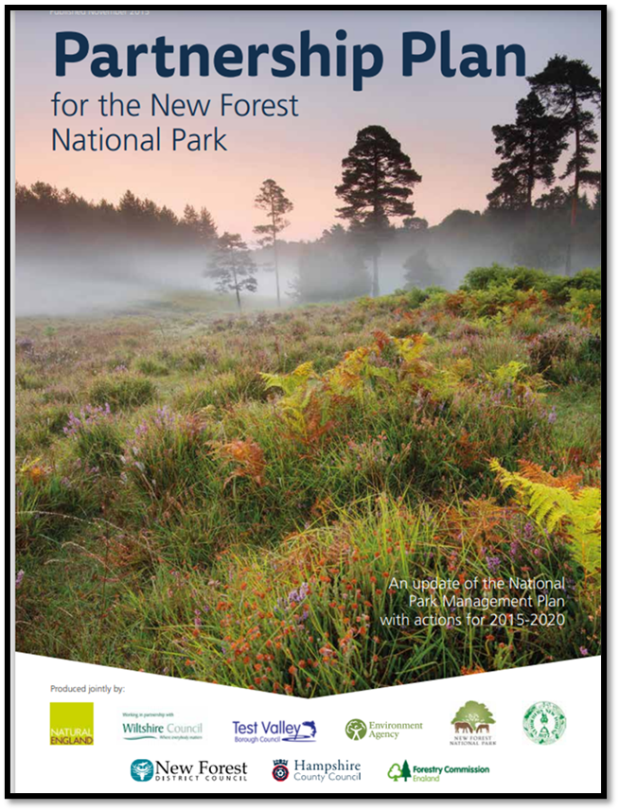
Updating the Partnership Plan
testing

Slide 2
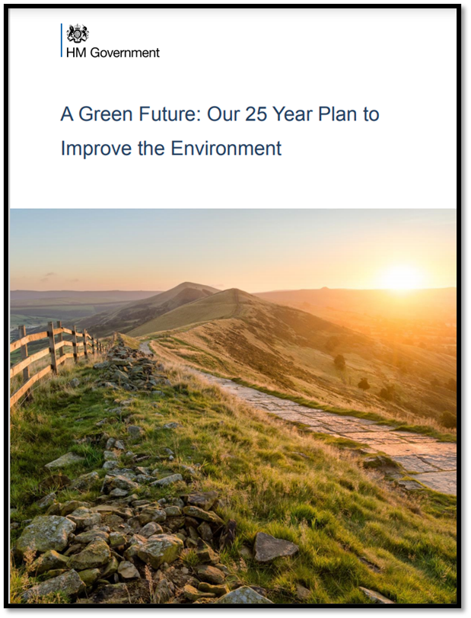
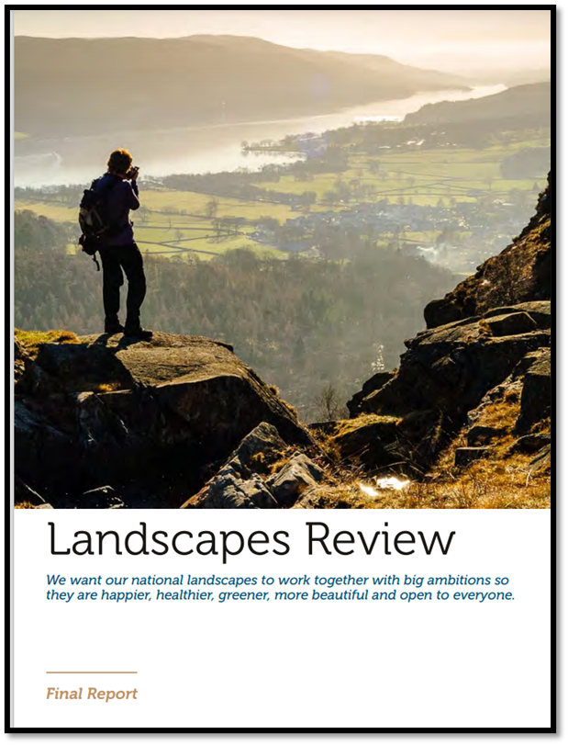
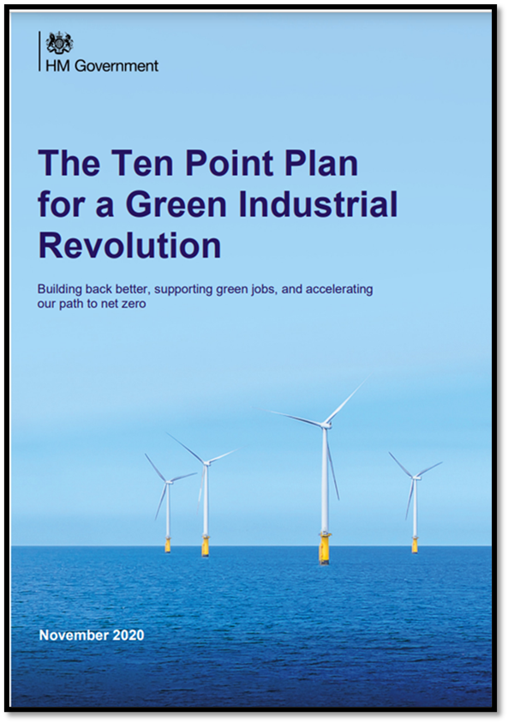
National policy context
testing

Slide 3
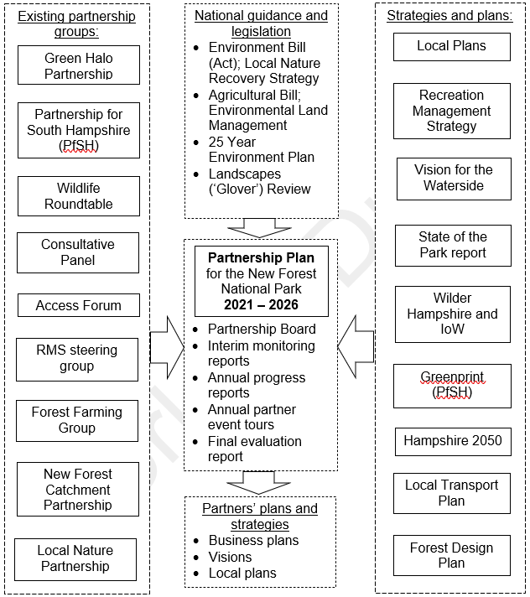
How the new Plan fits with existing forums, plans and strategies:
testing

Slide 4
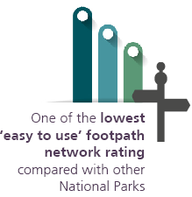
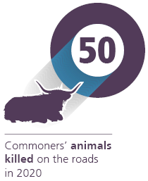
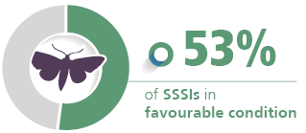
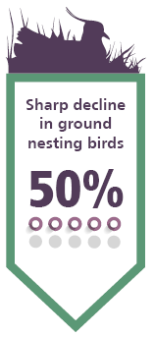

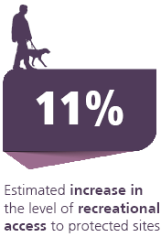
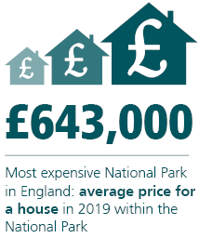
Challenges and opportunities:
testing

Slide 5
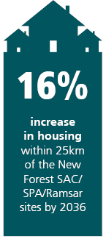
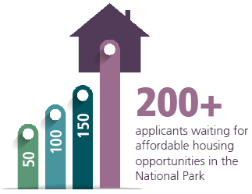
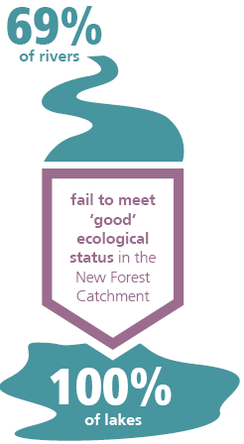
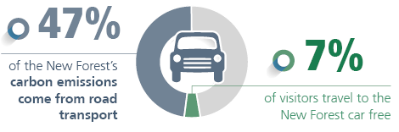
…continued:
testing

Slide 6
The new Plan will be built around five themes:
Nature recovery
Net zero with nature
Thriving Forest
An inclusive National Park
Team New Forest
testing

Slide 7
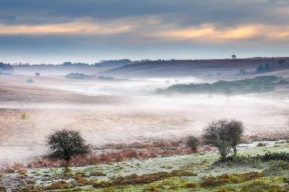
Nature Recovery
We will work together, and at scale, to maintain, reconnect and enhance nature. We commit to developing a nature recovery programme for the National Park that:
Makes more space for nature
Enhances Natural Capital
Supports nature recovery through the new Environmental Land Management Scheme (ELMS)
Ensures developers deliver a wider range of environmental benefits over and above the full environmental impact of the proposed development
Mitigates recreational pressures
testing

Slide 8
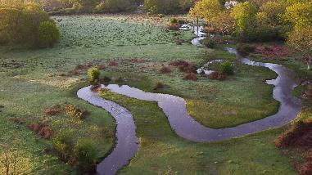
Net Zero with Nature
Net zero is achieved when harmful greenhouse gas emissions are balanced by an equivalent amount being absorbed by the atmosphere and landscape. We will do this through a programme of work that:
  Establishes baseline data and evidence
  Promotes nature-based solutions
  Builds a New Forest coalition for a Net Zero economy
  Activates communities
  Increases Sustainable Travel
Photo credit: Big Wave Ltd
testing

Slide 9
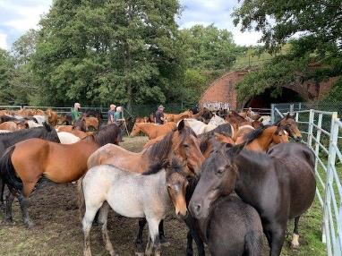
Thriving Forest
We will sustain a living, working Forest through support for cultural heritage, commoning, local produce, sustainable tourism, access to affordable homes and attracting high-value businesses. We will do this through a programme of work that:
Increases green skills and jobs
Supports Sustainable Land Management
Champions the future of New Forest Commoning
Supports New Forest Business and Green Tourism
Increases the availability of affordable housing
testing

Slide 10
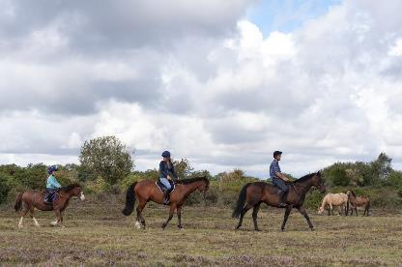
An inclusive National Park
People within reach of the New Forest, of all backgrounds, abilities and socio-economic groups, value the National Park as an important part of their lives and seek to care for it. We will do this through a programme of work that:
Promotes Health and Wellbeing
Connects People with Nature and Landscape
Leads inclusive place making, celebrates beauty and safeguards our cultural heritage
Copyright New Forest NPA with thanks to New Forest CDA

Slide 11
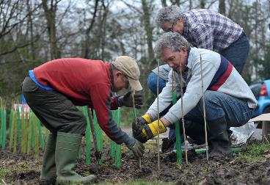
Team New Forest
Communities, businesses and organisations work together as a team to deliver the vision of the Partnership Plan, sharing knowledge, ideas and resources to deliver the best for the Forest through a programme of work that:
  Works with a wide range of people in our community and beyond
  Establishes strong partnerships and relationships within and beyond boundaries
  Leads the green agenda; seeking to influence, shape and innovate
  Develops our reputation as a ‘Centre of Excellence’ through our work together for the National Park and wider area

Slide 12
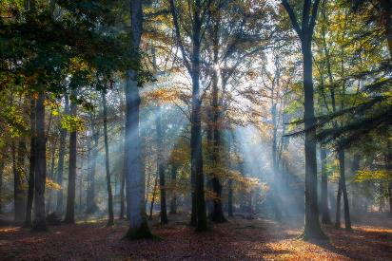

Next steps:
June: start of public consultation on Vision, Issues and Objectives
Consultation to run through July and August
September: review responses
October – December: new Plan agreed by NPA and partner organisations
testing

